Slide 1
Far East Bio-Tec Group
台灣遠東生物科技集團
New Drug Pipeline
Presentation
to Companies in CHINA Focus
Oct, 2020

Slide 2
Company Background
Founded | 1976
Characteristics | 1. Multinational Organic Certifications 2. Manufacturing certifications: GAP, GMP, ISO and HACCP 3. Global Sales: 60 countries
Founders | C.C. Chiueh
Employees numbers | 120

Slide 3
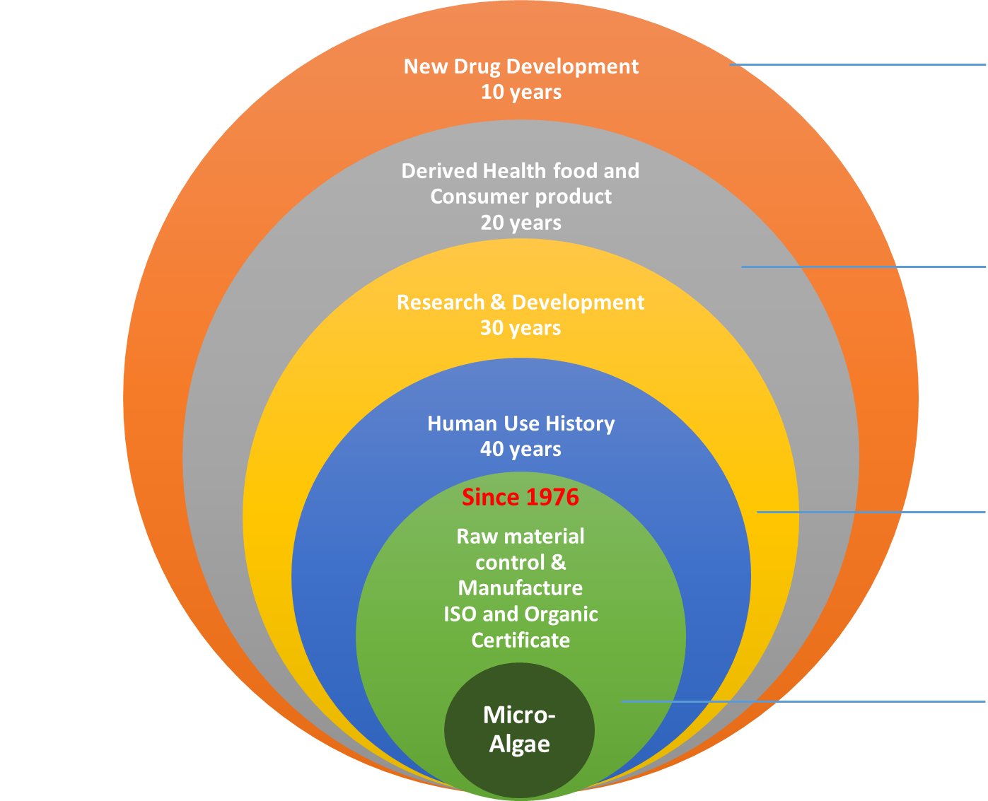
Company Introduction
Advanced Application
New Drug Development
R & D Technology Commercialization
Sustain Research and Development
Micro-organism
Long-Term History and Well Quality Control

Slide 4
New Drug Pipeline
 | Pre-clinical | Clinical trial |  |  |  | NDA
 |  | IND | I | II | III
Apomivir® ^{(FB-1603)}
ApoFev (Botanical)
FB-1807
FB-1808
IND120123 Influenza treat
COVID-19
2021 Q1
Liver Fibrosis
2021 Q2
Liver Fibrosis
2022 Q4
HBV sero-conversion
2022 Q2

