Slide 1
Better Embryo Selection: Giving Birth to IVF Success using Oxidative Stress as a Biomarker
Tzali Cnaani

Slide 2
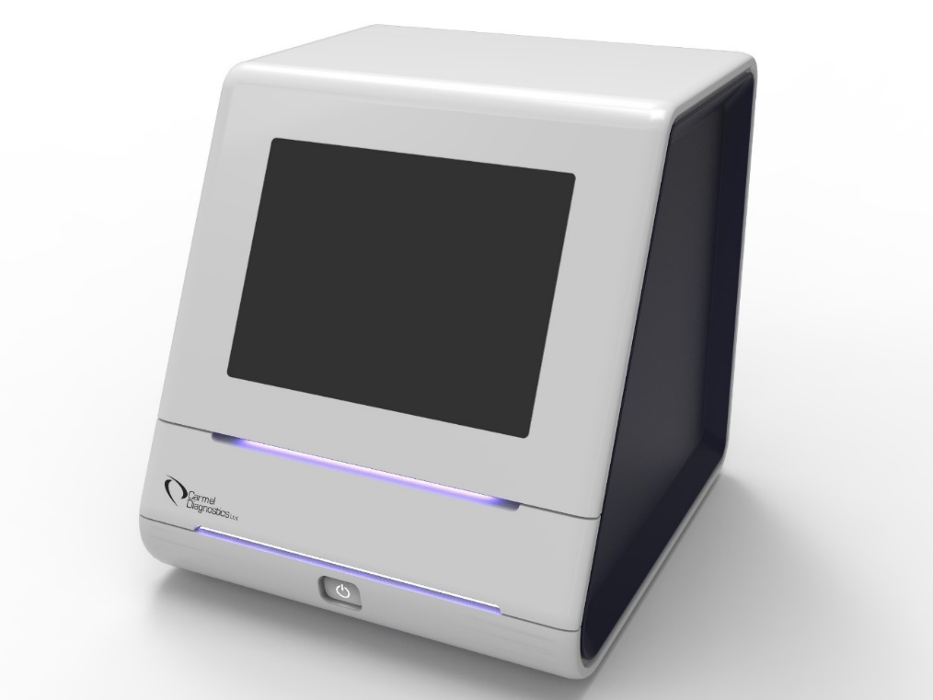
Carmel Diagnostics - Fertissimo A ground-breaking medical system selecting the most viable embryos for successful IVF pregnancy
1.
Up to 20% INCREASE in successful IVF pregnancies compared to the standard
of care
CE - MARK granted
Use Machine Learning for optimization
and continuous improvement
The device and technology are a platform for many additional applications (HF, Preeclampsia, AMD, TBI and more.)
2.
3.
4.

Slide 3
The Infertility pain
Up to 15% of couples suffer from infertility
The Solution: IVF – In Vitro Fertilization
Unfortunately, the success rate is very poor, and the process is lengthy and often very frustrating

Slide 4
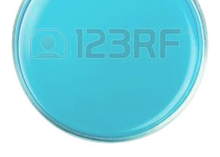
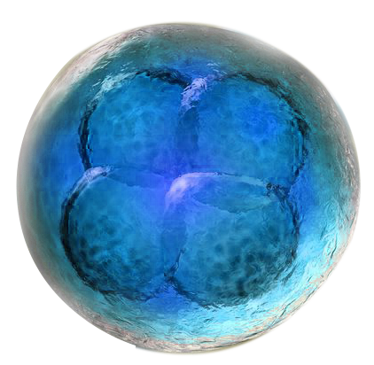
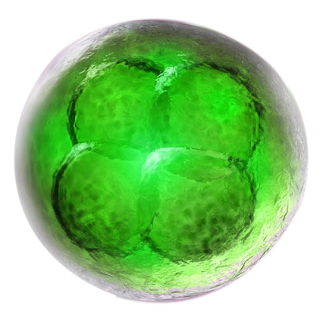
The Holy Grail of IVF is Embryo Selection The challenge:
To find the embryo with a HIGHER CHANCE to achieve PREGNANCY

Slide 5
Identification of the right embryo for transfer by using oxidative stress as a biomarker
Non-Invasive, Sensitive, Accurate,
Affordable solution
Up to 20% INCREASE in successful IVF pregnancies (compared with existing gold standard)
8 MINUTES analysis of embryo viability
Use AI, Bioinformatics and ML algorithms for optimization and continuous improvement
1.
2.
3.
4.

Slide 6
Current Status: 9-12 months from market
Proven in clinical studies
Company established
Solid partnerships
Industry recognition
Over USD 7M invested
PATENTS submitted
System is developed
and VALIDATED
CE-Mark granted
15-20% INCREASE in PREGNANCIES demonstrated over a gold standard
Clinical validation: IVI, the largest assisted reproduction group in the world
R&D ARAN, a leading engineering firm
Horizon 2020: EUR 2.7M (Phase 1 & 2)
Merck Serono: EUR 300K grant from GFI - Grant for Fertility Innovation
Other private investment

Slide 7
Business model: Pay-Per-Test
Sources of revenue
Expected income from single medium-size clinic
(500 cycles per year)
TCL Analizer sold at cost (12K$)
Consumables: PAY-PER-TEST model. Tray with cuvettes sold at a price of USD 30 per test (cost 3$)
Embryos per cycle | 7
Price per test (company income) | USD 30
Income per cycle | USD 210
Total annual consumable sales | USD 105,000
Addressable market: >3,500 assisted reproduction clinics worldwide
Market potential (Embryo selection) 500M$ (5-8% CAGR)
GTM through strategic partners/Distributors/Licensing

Slide 8
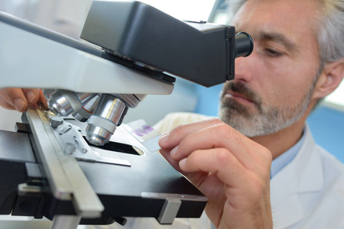
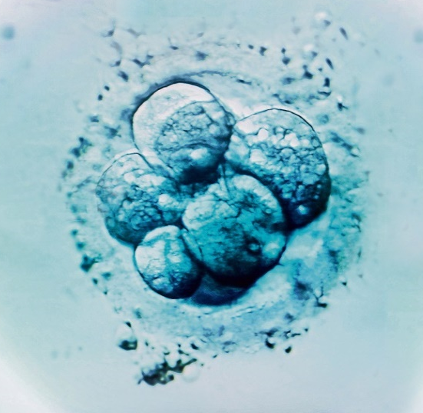
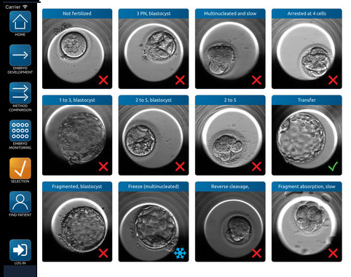
Current evaluation methods do not significantly increase success rates
Tests morphological symmetry and cleavage rate through microscopy
Subjective human error
100% of the total IVF cycles worldwide
Morphology
Zoomed pictures taken at fixed intervals within the incubator, calculating the cell-rate cleavage
Shown to improve outcomes by less than 10%
Players: Merck (GERI, Eeva) , Vitrolife (EmbryoScope)
Time-lapse monitoring
Fertissimo TCL Analyzer:
Objective, Sensitive,
Easy to use
Affordable

Slide 9
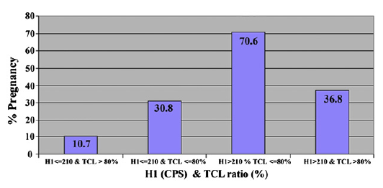
TCL values are indicative of outcomes - IVF Preliminary Trial
Implantation rate – Initial study - Fertility & Sterility (Fertil Steril. 2011 Mar 1;95(3):979-84.)

Slide 10
Clinical program generates impressive outcomes
Late 2016
Now
Pilot sample analysis for pregnancy viability on 76 embryos
Follow-up retrospective study on 732 embryos
Demonstrated an up to 20% increase in embryos carrying on to successful conception compared to gold standard
Significant correlation with success rate of a patient (p<0.05).
Detection of 231 samples demonstrated an increase in successful conception

Slide 11
Positive results Published
TCL Analyzer values are indicative of outcomes (%z)
Implantation rate from study (Q4/2016).
The higher the values obtained by our TCL Analyzer (c/s – counts per second), the better the chances of pregnancy

Slide 12
Future roadmap: Multiple indications in oxidative stress Accumulated Potential market -- MultiBillion $
Early diagnosis of Alzheimer’s,
Parkinson and ALS
Traumatic Brain Injury
Age Related Macular
Degeneration (AMD)
Risk stratification for Heart
Failure patients (Proof of
concept study published)
Renal Failure
Early identification of
Preeclampsia (pilot running)
Carmel Diagnostics

Slide 13
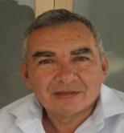
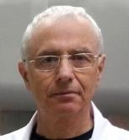
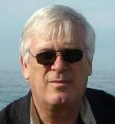
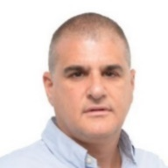
Team
Tzali Cnaani, CEO
An experienced manager with wide expertise in product development and implementation, business development, and operations.
Sergei Shnizer (MD, Ph.D.), CTO
The inventor of the TCL Analyizer. Vast experience in research and development, clinical studies, and medical applications.
Moni Shavit, Product Manager
Over 25 years of experience in business and technology development, R&D, and engineering of medical devices and systems
Amnon Weichselbaum (Ph.D.) – Business Development Advisor
Life Sciences expert, products developer, entrepreneur
Experienced executive
Prof. Aaron Ciechanover MD, Ph.D.
Nobel Prize Laureate Chemistry 2004
Advisor
Notes:
Include the key people behind the team and the strategic partners (investors, commercial partners, industrial partners, manufacturing partners, etc.) that will be instrumental in making the company successful.

Slide 14
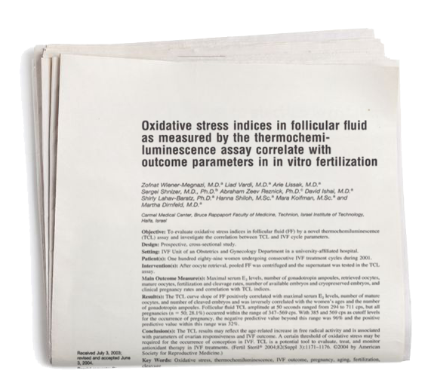
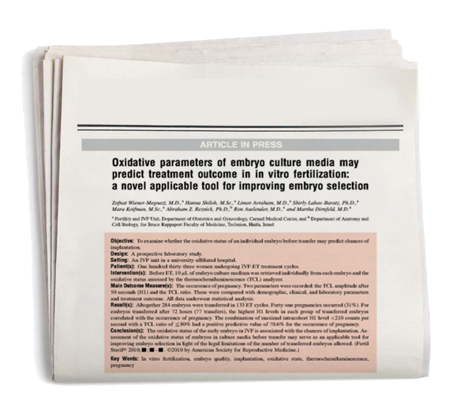
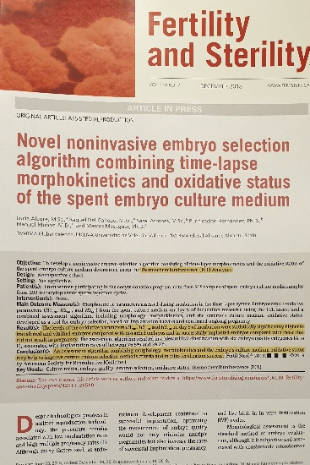
Proof of principle studies recognized
“Parameters obtained (by the TCL analyser) show higher levels in group culture, transferred embryos and SUCCESSFUL IMPLANTATION.
Our current evidences between embryo outcome and implantation potential may lead to an IMPROVED CLINICAL BIOMARKER”.
Dr. Marcos Meseguer
Scientific Manager, IVI Valencia
Publications in internationally recognized scientific papers:

Slide 15
Fertissimo Roadmap
2019 |  |  | 2020 |  |  |  | 2021
Q2 | Q3 | Q4 | Q1 | Q2 | Q3 | Q4 | Q1 | Q2 | Q3 | Q4
Reengineering & production of 10 test units 4th generation
Conduct pivotal validation trial
CE mark clearance
European Launch
US Clearance (FDA)
US Launch

Slide 16
Needed Resources
Financing needs Growth potential, Profitability
Prepare for market launching
Build manufacturing infrastructure
Further software development
Further certifications (FDA, NMPA, others)
Extend R&D of additional applications – great potential
Working Capital to start production and make trial units
Seeking 5M$ investment
High ROI, growth potential
Exit strategy
Acquisition by major industry players, IPO

Slide 17
IVF success and beyond
Tzali Cnaani – CEO
tzali@carmel-diagnostics.com

